Slide 1

Lecture 2
Introduction to SAP Finance (FI)
FIN319

Slide 2
Learning Objectives
Review of basic Finance management topics
Understand the goal of SAP Finance (FI)
Understand the purpose, master data and reporting of New GL
Understand the purpose, master data and reporting of AR
Understand the purpose, master data and reporting of AP
Understand the purpose, master data and reporting of AM
Understand the integration points between FI and the rest of the FI sub-modules.

Slide 3
Financial Review

Slide 4




Finance Review
Financial Statements
Review
Statement of Financial Position - Balance Sheet
Income Statement
Statement of Cash Flow
Statement of Changes in Equity
    Reports the firm’s assets, liabilities and equity at a given point of time
    Reports the firm’s income, expenses, and profits over a period of time
Reports the firm’s cash flow activities (operation, investing and financing)
Explain the changes of the firm’s equity over a period of time
Financial Statements

Slide 5
Finance Review
Balance Sheet
Review
  The Balance Sheet Reports the firm’s assets, liabilities and equity at a given point of time
Assets
  Current (life less than one year)
  Fixed (life longer than one year)
Liabilities and Owners’ Equity
  Current (life less than one year)
  Long term ( life longer than one year)
Balance Sheet Identity
  Assets = Liabilities + Stockholders’ Equity
Assets
Fixed
Liabilities+ Equity
Equity
Current
Current
Long term

Slide 6
Finance Review
Working Capital and Liquidity
Review
Net working capital
  Difference between Current Assets and Current Liabilities
  It indicate whether the firm has sufficient short term assets to cover its short term obligations
Liquidity
  It refers to the speed and ease in which an asset can be converted to cash without significant loss of value
  Liquidity is valuable in avoiding financial distress
Assets
Fixed
Liabilities+ Equity
Equity
Current
Current
Long term
Net working capital

Slide 7
Finance Review
Debt vs. Equity
Review
Debt and Equity are sources of financing for the firm
The use of debt in a firm’s capital structure is called financial leverage
The more leverage, the higher the risk of financial distress
Assets
Fixed
Liabilities+ Equity
Equity
Current
Current
Long term

Slide 8
Finance Review
Income Statement
Review
Sales (Revenue)
Net income
Dividends
Return to Equity
COGS
Operating exp (General expenses, depreciation, etc)
Interest
Tax
Gross Profit
EBIT
The income statement measures performance over a specified period of time (period, quarter, year).
Income Statement Equation(s):
  EBIT = Net sales – COGS – Operating expense
  Net Income = EBIT – Interest - Tax
  Addition to REA = Net income - dividends
Net income elements
  Dividends paid to shareholders
  Addition to retained earnings

Slide 9
Finance Review
Market versus Book Value
Review
Book value corresponds to the balance sheet value (according to US GAAPs) of the assets, liabilities, and equity and is generally not what they are actually worth.
Market value or true value corresponds to the price at which the assets, liabilities, or equity can actually be bought or sold and it is relevant for managers and investors.
US Firm Balance Sheets Book vs. Market Value
Assets |  |  | Liabilities and Equity
 | B | M |  | B | M
Current | 100 | 300 | Current | 70 | 100
Net fixed assets | 500 | 600 | Long term | 200 | 200
 |  |  | Equity | 330 | 600
Total Assets | 600 | 900 | Total L&E | 600 | 900

Slide 10
Finance Review
Difference between Accounting Income and Cash Flow
Review
Income Statement is not a measurement of Cash Flow
Net Sales of $5,000 with cash collection of $3,500
Recognize revenue when it is fully earned, not when cash is received
Recognized expenses needed for the generation of revenue, not when cash is paid
01
Sales of $5,000
Income Statement vs
Cash Flow
Accrual Basis
Accounting
Non-cash items in the
Income Statement
02
Cash from sales of $3,500
Expenses charged against revenue that do not affect cash flow. The most important is depreciation.

Slide 11
Finance Review
Statement of Cash Flow
Review
  The Statement of Cash flow identify the sources of cash over a period of time and its use. It is classified by:
Financing:
  Loans or financing activity
Operating.
  From the operation of the company
Investing.
  Asset investing
Financing
Operating
Investing

Slide 12
Introduction
SAP Finance (FI)

Slide 13
SAP Finance
Goal
Financial accounting is designed to collect the transactional data that provides a foundation for preparing the standard portfolio of reports.
In general, these reports are primarily, but not exclusively, directed at external parties.
Standard reports include:
  Balance Sheet
  Income Statement
  Statement of Cash Flows
Internal
Executives
Senior Management
Admin staff
Employees
External
Legal authorities
Banks
Auditors
Shareholders
Insurance
Tax authorities
Media
Financial Analytics

Slide 14
SAP Finance
Business process: Record to Report
Covers the process from the recording of a transaction to the analysis.
Transaction
Financial consolidation
GL close
Accounting provisions
Analysis
Tax and statutory reporting
It involves the collecting, processing, and delivering information that is relevant, accurate and timely. It provides the feedback needed in the organization to understand what is its the financial performing.

Slide 15
SAP Finance
S/4 Finance
SAP Finance also known as Simple Finance or S/4 Finance is segmented in multiple elements that comprise what SAP ERP used to called FI/CO.
  Financial Planning and Analysis
  Accounting and Financial Close
  Treasury Management
  Invoice Management and Accounts Payable
  Accounting and Closing Ops
  Accounting
  Cost Management and Profitability Analysis
Financial Planning & Analysis
Accounting and Financial Close
Treasury Mgnt
Invoice Mgnt & AP
Accounting & Closing Operations
Accounting
Cost Mgnt & PA
Products
Digital Core
S/4 HANA

Slide 16
SAP Finance
S/4 Finance: Financial Planning and Analysis
Use for the Financial Forecast of the organization, what if scenarios and other elements to improve financial decision making.
Benefits
  Financial and strategic planning
  Forecasting and budgeting
  Financial analytics and reporting
  Performance management
Financial Planning & Analysis
Accounting and Financial Close
Treasury Mgnt
Invoice Mgnt & AP
Accounting & Closing Operations
Accounting
Cost Mgnt & PA
Products
Digital Core
S/4 HANA

Slide 17
SAP Finance
S/4 Finance: Accounting and Financial Close
Use for the running and automation of the financial consolidation and compliance reporting
Benefits
  Financial consolidation
    Interco elimination
    Investment consolidation
  Closing process accounting
    Currency translation
  Consolidated Financial reporting
  Financial compliance and regulations
Financial Planning & Analysis
Accounting and Financial Close
Treasury Mgnt
Invoice Mgnt & AP
Accounting & Closing Operations
Accounting
Cost Mgnt & PA
Products
Digital Core
S/4 HANA

Slide 18
SAP Finance
S/4 Finance: Treasury and Financial Risk Management
Use for the optimization of working capital and financial risk management
Benefits
  Corporate treasury management
  Cash flow forecasting and management
  Financial and liquidity risk
    Provides finance risk management tools around currency conversion rates
    Mitigate currency risk and provide hedge accounting tools
  Debt and investment management
Financial Planning & Analysis
Accounting and Financial Close
Treasury Mgnt
Invoice Mgnt & AP
Accounting & Closing Operations
Accounting
Cost Mgnt & PA
Products
Digital Core
S/4 HANA

Slide 19
SAP Finance
S/4 Finance: Finance Operations
Use for the recording of the financial needs of the organization and the focus of this lecture
Benefits
  Universal Ledger
    Financial transactions recording
    Asset Management
  Accounts Payable and Receivables
    Credit evaluation
    AP and AR subledger
Financial Planning & Analysis
Accounting and Financial Close
Treasury Mgnt
Invoice Mgnt & AP
Accounting & Closing Operations
Accounting
Cost Mgnt & PA
Products
Digital Core
S/4 HANA

Slide 20


SAP Finance
The case of Airbus
A manufacturing company in a very competitive industry needs real-time visibility. How to improve the ecosystem and improve financial close cycle by 50%?

Slide 21
SAP Finance Operations (FI)
Organizational Structure
Org
Represents the legal and/or organizational views of an enterprise and it forms a framework that supports the activities of a business in the manner desired by management
Represents an independent legal accounting unit.
Balanced set of books, as required by law, are prepared at this level.
An organizational unit that represents separate areas of operations or locations within
an organization.
Company code
Credit Control
Client
Chart of Accounts
An independent environment in the system.
  A classification scheme consisting of a group of general ledger accounts.
  Provides a framework for the recording of values to ensure an orderly reporting.

Slide 22
SAP Finance Operations (FI)
Organizational Structure (Cont)
Org
An organization unit that allows you to control the legal valuation of assets. They are usually country specific and can be assigned to multiple company codes.
Chart of Depreciation
An organizational entity which grants and monitors a credit limit for customers.
It can include one or more
company codes.
Business
Area
Ledger
Segments
An organization unit that allows you to produce financial statements according to different accounting principles.
An organizational unit that represents separate areas of a company with activities that generate expenses and revenues.

Slide 23

SAP Finance Operations (FI)
Global Bike Finance Structure
One Operating concern
Two controlling areas
Two company codes
One chart of accounts
Two business areas
One credit control area
Global Bike
Client
Global Concern
Operating Concern
North America
Europe
Controlling Areas
Global Bike Inc
Global Bike Germany GmbH
Company code
Global CoA
Chart of Accounts
Bikes
Accessories
Business Areas
Global Credit Control
Credit Control

Slide 24
SAP Finance Operations (FI)
Sub-modules
GL
General Ledger
Use to record the financial impacts of business process steps. It constrains the data for financial reporting.
UJ
Financial Planning & Analysis
Accounting and Financial Close
Treasury Mgnt
Invoice Mgnt & AP
Accounting & Closing Operations
Accounting
Cost Mgnt & PA
Products
AM
Asset Management
Is used to record data related to the purchase, use and disposal of assets.
AP
Accounts Payable
Is associated with the procurement process and is used to managed money owned by vendors for the purchase of materials and services
Digital Core
S/4 HANA
AR
Accounts Receivable
Is associated with the fulfillment process and is used to manage money owned by customers for good and services sold

Slide 25




SAP Finance Operations (FI)
Data Types
Master records
Single source of common business data used across SAP.
Transactional records
Data that represents a financial event.
GL account
General Ledger
Financial transactions
Cost element
Asset Management
AM Subledger
Vendor
Accounts Receivable
AR Subledger
Customer
Accounts Payable
AP Subledger
Asset

Slide 26
SAP Finance Operations (FI)
Master data extension
Company code level
Client level
North America
Europe
75123
75123
75123
GL account
Cost element
75123
Vendor
12001
12001
12001
Customer
100
100
100
Asset
2000010

Slide 27
SAP Finance Operations (FI)
Master data copy
Company code level
Client level
North America
North America/ Europe
75123
75123
75200
GL account
Cost element
75123
Vendor
12001
12001
12010
Customer
100
100
200
Asset
2000010

Slide 28

SAP Finance Operations (FI)
Reflection
What would be the most likely currency for the GBI financial consolidation and why?
What type of regulations may apply the setting of currencies and its configuration at the company code level?

Slide 29
General Ledger (GL)
Part of Universal Journal
SAP Finance (FI)

Slide 30
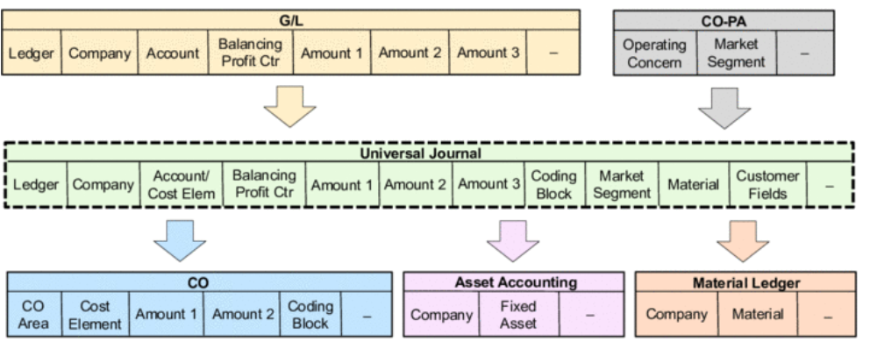
Universal Journal
Introduction
GL
It brings together the SAP FI and CO components into a place. This “single source of truth” collects all accounting transactions with its costing elements.
  General Ledger (FI)
  Asset Accounting (FI)
  Controlling (CO)
  Profitability Analysis (CO)
  Material Ledger (CO)

Slide 31
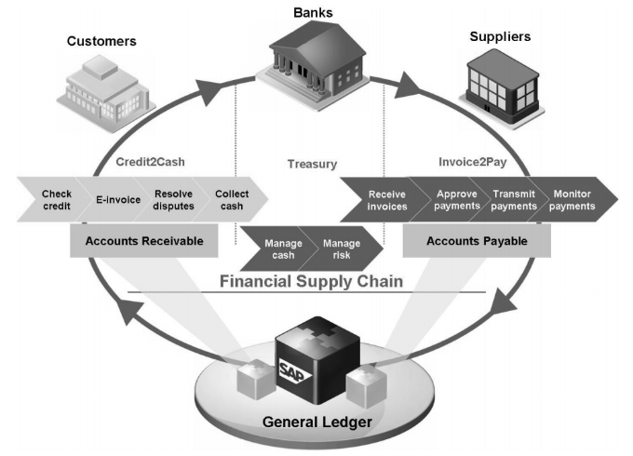
General Ledger
Introduction
GL
The central task of G/L accounting is to provide a comprehensive picture of external accounting and accounts.
The general ledger serves as a complete record of all business transactions.
Managed at the company code level, where all accounting-relevant transactions are recorded here

Slide 32
General Ledger
Benefits
GL
Parallel
Accounting
Allows you to post in multiple currencies and satisfy reporting needs according to local accounting regulations (GAAP).
Document
Splitting
Extend allocation methodology to the balance sheet to create whole financial statements by business unit.
General Ledger
Segment
Reporting
Allow you to create financial statement is adherence to IFRS (International Accounting Standards).
Ledger
Consolidation
Consolidate the SAP Finance (FI) and Controlling (CO) into a single journal instead of multiple ones. This allows to speed financial processes and close.

Slide 33
General Ledger
Ledgers & Currencies
GL
Ledgers are used to record financial transactions by account
Company codes can have:
  One leading ledger and multiple non-leading (parallel) ledgers
  independent currencies
Leading Ledger
US GAAP
German HGB Ledger
Transaction
Document currency
Local
Reporting currency
Group
Consolidation currency
You can use up to four currencies per company code
  Transaction currency
  Company code (local) currency
  Group currency
  Hard currency

Slide 34
General Ledger
Parallel Accounting
GL
Leading Ledger
US GAAP
German HGB Ledger
Leading ledger
  Follows the accounting principals of the company’s consolidated financials
  It can contain up to 3 currencies
Transaction
Document currency
Local
Reporting currency
Group
Consolidation currency
E.g. EUR
E.g. USD
Non-leading ledgers
  They are used for parallel accounting and can be linked to one of the existing currencies
  Can have different fiscal years

Slide 35
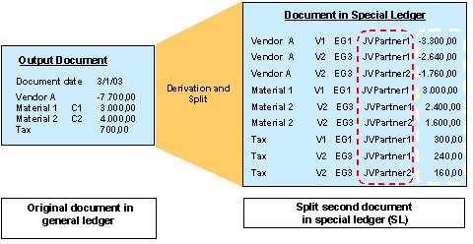
General Ledger
Document splitting
GL
New General Ledger functionality that allows organizations to split documents line
Advantages
  Reduces the time and effort for the user to enter documents by deriving segment from profit center which can be derived from a cost object
    cost center,
    internal order, or
    project
  Allow a company to create real time balance sheets for segments creating a view for working capital analysis.

Slide 36




General Ledger
Document Principle
GL
Unique document
Recall document
Critical info
Can not be deleted
Each business transaction impacting FI writes data to the SAP database creating a uniquely numbered electronic document.
The document number can be used to recall the transaction at a later date.
It contains, information like the responsible person, date and time of transaction, and commercial content
Once a financial document is written to the SAP database can not be deleted , although it can be changed to some degree or reverse its effect.
The SAP document principle provides a solid and important framework for a strong internal control system – a requirement of law for companies that operate in the United States and in most other countries in the world.

Slide 37
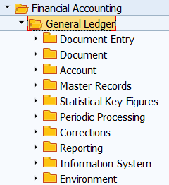
General Ledger
Transactions
GL
Tcode | Description | Type
FS00 | GL master record | Master data
KA01 | Primary cost element | Master data
FB50L | Enter GL account for ledger group | Transactional
FB03 | Display document | Transactional
FB08, FB80 | Reverser document | Transactional
FAGLL03 | Display GL account items | Transactional
FAGLB03 | Display balances | Transactional
F.01 | Run financials | Transactional

Slide 38
General Ledger
Master Data: GL Account (FS00)
GL
General Ledger Accounts are master data that in the GL that belongs to the Chart of Account (CoA).
Client level
Company code level
Account
Description
Currency and tax data
Account group
Group accounts depending of a defined criteria
P&L or Balance sheet
Reconciliation account
Control sub ledgers
Field status group
It controls fields requirements during posting
Line control
Open item management
Line item display

Slide 39
General Ledger
Global Bike Chart of Accounts
Balance Sheet
  Current Assets 1XXXXX
  Inventory 20XXXXX
  Fixed Assets 22XXXX
  Current Liabilities 3XXXXX
  GRIR 31XXXX
  Long term liabilities 32XXXX
  Equity 329XXX
  Retained earnings 330000
Profit & Loss
  Revenue 6XXXXX
  Labor 700000
  Consumption expense 72XXXX
  Expenses 74XXXX
  Price variance 760000
  Production variance 760100
  R&D 78XXXX
  COGS 79XXXX

Slide 40
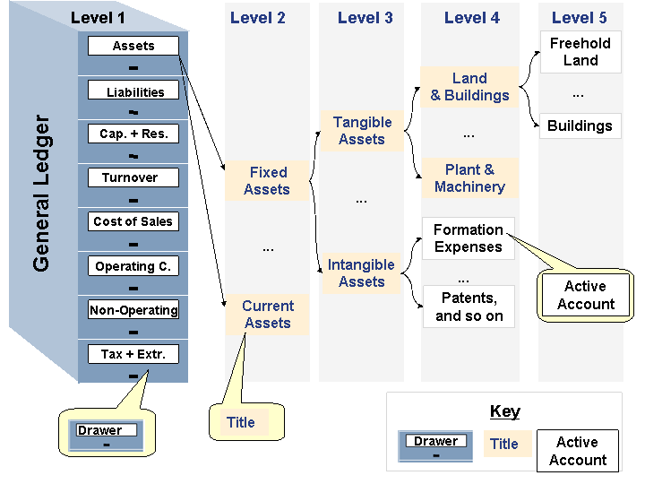
General Ledger
Master data: Account Group
GL
Classify G/L account into user defined segments
Determine the number range of the accounts that will fall into these segments
Determine field status (suppress, required, display, and optional)

Slide 41
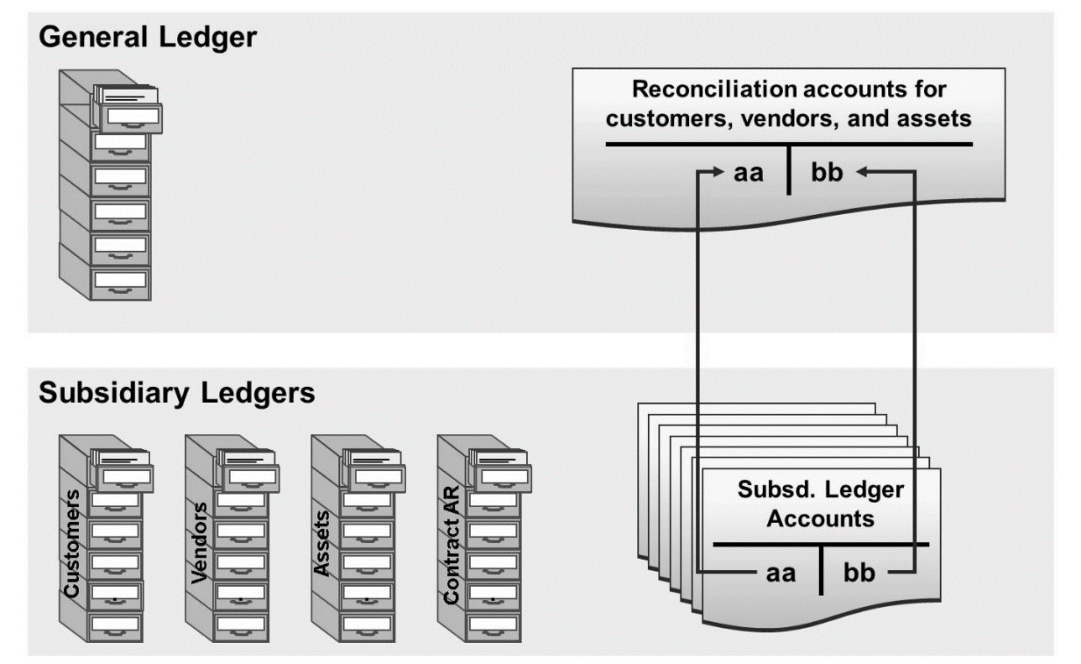
General Ledger
Master Data: Reconciliation account
GL
For each sub ledger account you must keep at least one reconciliation account in the general ledger.
Sub ledger postings automatically posts to the corresponding reconciliation account in the general ledger.
You can not manually post directly to reconciliation accounts.
Ensures real-time integration of sub ledger accounts and the general ledger

Slide 42
General Ledger
Master Data: Primarily Cost Element (KA01)
GL
When an expense is occurred in FI it is passed into CO by cost element accounting as a single sided posting.
Primary cost elements have to exist in the FI GL maser record before they can be created as primary cost elements in CO.
Primary cost elements create the link between FI and CO
Finance
Controlling
GL Master Record
Primary Cost Element to link FI and CO
P&L accounts
Controlling area
Validity
Category (1 or 11)

Slide 43
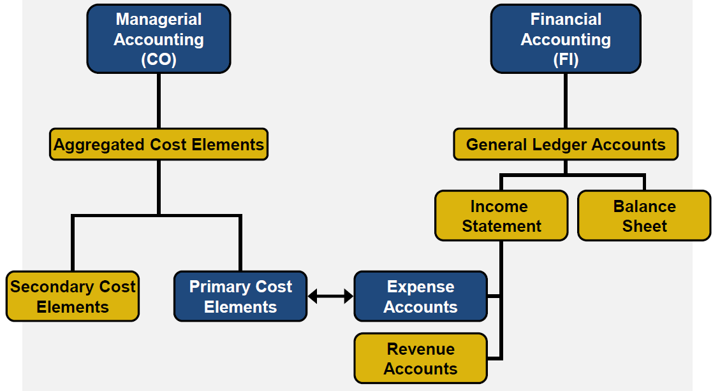
General Ledger
GL account link with Primary Cost Element
GL
When an entry is posted in FI to a G/L Account that is a cost or revenue account and a corresponding primary cost element exists in CO, then a corresponding entry is posted in CO.
This is a one sided entry to get the expense or revenue into CO.
A controlling object needs to be specified in the FI document to define where to post the costs in CO
75###5 Rent
75###5 Rent

Slide 44
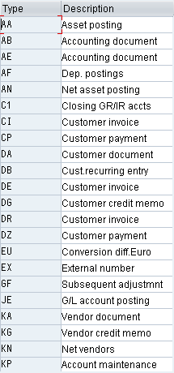
General Ledger
Document entry: Document type
GL
Two character alphanumerical key that distinguish different business transactions and classify accounting documents
Controls
  Document ranges
  Account types allowed
  Type of transactions allowed
*List on the right is a sample of the document type list

Slide 45
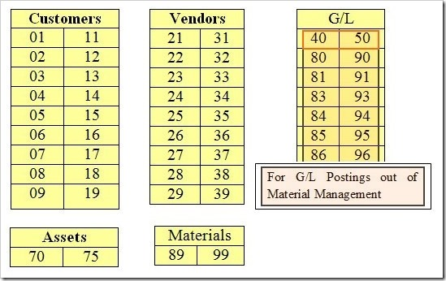
General Ledger
Document entry: Posting Key
GL
Two character numerical key that controls the entry of line items
Determines
  Account type
    D for customers
    K for vendors
    S for GL
    A for assets
    M for materials
  Debit/credit posting
  Field status of additional data
  Layout of entry screens

Slide 46

General Ledger
Document entry: Simulate, Parking, Post
GL
Simulate. It allows you to review a document before posting or parking it.
Parking. It allows you to save a document in a transit space allocating a document but not creating a financial effect.
Post. It saves the document in the system allocating a document and creating a financial effect.
Simulate
Park
Post

Slide 47
General Ledger
Document entry: Financial impact
GL
Company code
Posting & Document date
Transaction date
Document number
Currency
Line items
  GL accounts
  Posting key (debits and credits)
  Amounts
Document date:
09/01/2018
Company code:
US00
Posting date:
09/01/2018
Currency:
USD
Document Number
1XXXXXXX
Transaction date:
09/15/2018
Item in document currency
Line
PK
Account
Cost center
Amount
001
40
75XXXX Rent
ABC IT
$3,000.00
002
31
123 Vendor X
$3,000.00-

Slide 48
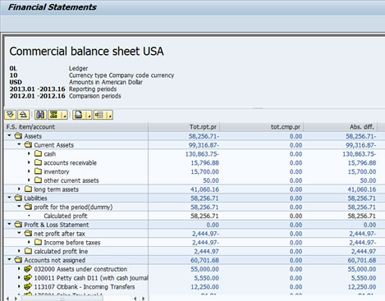
General Ledger
Run Financials: Financial Statement Version
GL
To meet various reporting requirements, various financial statement versions have been created in the system.
You define exactly which accounts appear in which line items of the financial statement

Slide 49
General Ledger
Reflection
What currencies would be involved in a FI transaction on Global Bike Inc?
What currencies would be involved in a FI transactions on Global Bike Germany?
What implications/benefits/uses may have document splitting functionality for finance?
What functionality or functionalities of the new GL would your recommend to implement to address GAAP differences between countries and why?
What internal control benefits would you highlight from the implementation of SAP ECC?

Slide 50
Asset Management (AM)
Part of Universal Journal
SAP Finance (FI)

Slide 51
Asset Management
Introduction
AM
Asset Master
Acquisition
Depreciation
Sales
Transfers
Retirement
Records and manage accounting data for all fixed assets
  Part of the Universal Journal it manages all asset transactions (acquisitions, transfers, sells, retirement, depreciation) are controlled by asset management during its life and calculate asset depreciation
AM is integrated with AR and AP
  Postings in AR and AP are simultaneously recording in asset management
  Postings in asset management are simultaneously recorded in the G/L

Slide 52
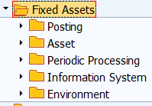
Asset Management
Transactions
AM
Tcode | Description | Type
AS01 | Asset master record | Master data
F-90 | Acquisition with vendor | Transactional
AW01N | Asset Explorer | Transactional
F-92 | Retirement with customer | Transactional
AFAB | Depreciation run | Transactional
AB08 | Reverse document | Transactional

Slide 53
Asset Management
Master Data: Asset Master
AM
Asset Master Record contains data to track the financial consequences associated with the entire lifecycle of an asset.
General (Company code)
Dep. Areas (Chart of Depreciation)
Description
Depreciation key
Account determination
Controls the GL postings based on the asset class
Asset class
Cost centers and plant
Origin data
Useful life
Dep. Start date
Change over year

Slide 54
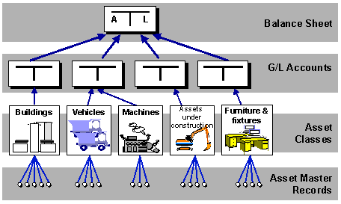
Asset Management
Master data: Asset Class
AM
Grouping of assets with possess similar characteristics
  Asset classes created at client level (apply to all company codes)
  Each asset class is associated to a reconciliation account via account determination
Each asset has to be assigned to an asset class.
There is at least one special asset class for assets under construction and one for low-value assets.

Slide 55
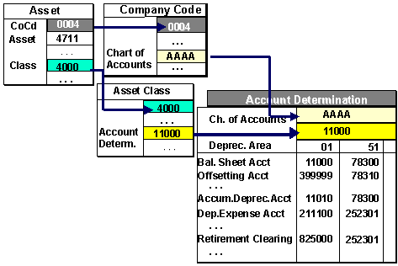
Asset Management
Master data: Account Determination
AM
It create the link between the asset master record and the GL
Each asset class is assigned to an account determination but it is possible to have unique account determination per chart of depreciation
Each account determination is associated with a depreciation area
Each account determination holds the GL accounts for
  Acquisitions, depreciation and retirement

Slide 56
Asset Management
Master data: Dep. areas and dep. keys
AM
Depreciation area
  Chart of depreciation specific
  Used to calculate different values in parallel for each fixed asset for different purposes an can be linked to different ledgers.
  Various data is stored in the asset master record for depreciation areas which control the calculation of normal and special depreciation for the special depreciation areas.
Depreciation key
  Depend from the depreciation area
  Can use different depreciation method for general business procedures from the depreciation method required by tax authorities.
CoD
Dep area 01
Dep area 02
Dep area 03
Dep keys
Dep keys
Dep keys
GL

Slide 57
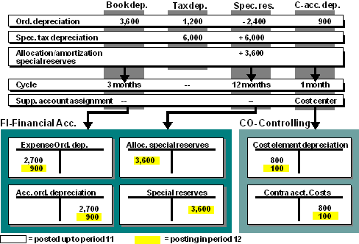
Asset Management
Depreciation run (AFAB)
AM
Only after the depreciation posting run has been completed is the depreciation actually posted in asset accounting and in the General Ledger
The depreciation is posted to the corresponding depreciation accounts in the General Ledger and to the assigned CO cost object assigned to the asset master record.

Slide 58
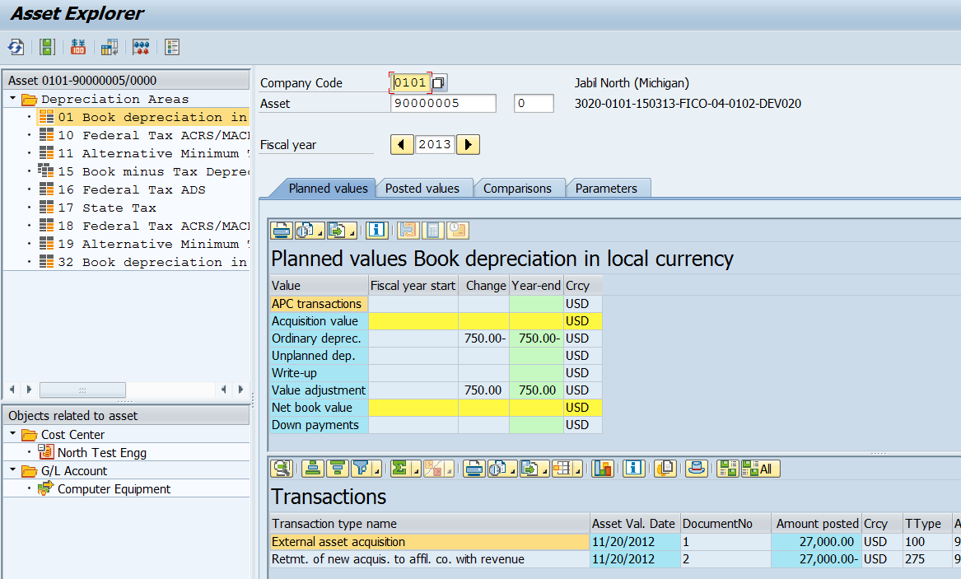
Asset Management
Asset Explorer
AM
Offers a clear overview of the activity for an asset.
You can see transactions that have been posted to the asset plus planned and posted depreciation per depreciation area, per period for each fiscal year.
You can drill down to the details of the FI transactions.
It is possible to branch to master data, other cost objects, and perform simulations.

Slide 59
Asset Management
Reflection
What is the relevancy of the asset master records in the asset life cycle process?
What role do you think the chart of depreciation play to address GAAP differences between countries and why?
How do you link the asset sub-ledger and the postings to FI?

Slide 60
Accounts Receivable (AR)
SAP Finance (FI)

Slide 61


Accounts Receivable
Introduction
AR
OTC
PTP
PRD
RTR
HTR
Billing
GL
Customer
Records and manages accounting data of all customers.
Postings made to accounts receivable are also recorded directly in the G/L.
Integral part of Order to Cash business process.
AR is integrated with SD and Treasury (order to cash process)

Slide 62
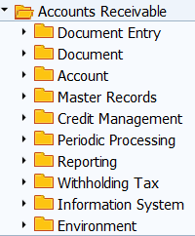
Accounts Receivable
Transactions
AR
Tcode | Description | Type
XD01, FD01 | Customer master record | Master data
FB70 | Enter Invoice | Transactional
FB03 | Display document | Transactional
F-28 | Incoming payments | Transactional
FB08, FB80 | Reverse document | Transactional
FDL1N | Account line items | Transactional
FD10N | Display balances | Transactional

Slide 63
Accounts Receivable
Master Data: Customer Master
AR
Customer Master Account is data needed to conduct business with customers and execute transactions related with fulfillment process.
General (Client)
Accounting (Company code)
Account
Name
Address
Bank information
Payment terms
Payment method
Reconciliation account
Cash management group

Slide 64

Accounts Receivable
Sub-ledger and Open Item Management
AR
GL Account (reconciliation)
  For each sub ledger account you must keep at least one reconciliation account in the general ledger.
Subledgers (customers)
  Sub ledger postings automatically posts to the corresponding reconciliation account in the general ledger.
Open item management
  Allows you to control if an AR document is paid (cleared) or not.

Slide 65
Accounts Receivable
Credit Management
AR
Accounts are processed on the basis of credit segment in the customer master record. This is maintained in a separate data basis in SAP credit management.
Credit data includes all information about a business partner that is required to monitor credit risk
  Credit profile data
  Credit segment data
Credit Profile
  Contains the procedure for scoring and credit limit calculation, the internal scoring, and sometimes external business partner ratings.
  Also includes risk class, check rules for controlling credit limit check, and notes.
Credit Segment
  Contains all the data required for checking credit when a sales order is accepted and the resulting order-related credit decision.
  You can define a main credit segment as well as additional credit segments for company codes.

Slide 66
Accounts Receivable
Invoice entry: Financial impact
AR
Company code
Posting & Document date
Transaction date
Document number
Currency
Line items
  Customer (debit)
  GL accounts (debit)
  Amounts
Document date:
09/01/2018
Company code:
US00
Posting date:
09/01/2018
Currency:
USD
Document Number
1XXXXXXX
Transaction date:
09/15/2018
Item in document currency
Line
PK
Account
Amount
001
01
456 Customer Y
$4,000.00
002
50
60XXXX Revenue
$4,000.00-

Slide 67
Accounts Receivable
Incoming Payments: Financial impact
AR
Company code
Posting & Document date
Transaction date
Document number
Currency
Line items
  Customer (debit)
  GL accounts (debit)
  Amounts
Document date:
09/16/2018
Company code:
US00
Posting date:
09/16/2018
Currency:
USD
Document Number
1XXXXXXX
Transaction date:
09/18/2018
Item in document currency
Line
PK
Account
Amount
001
40
10XXXX Bank
$4,000.00
002
15
456 Customer Y
$4,000.00-

Slide 68
Accounts Payable (AP)
SAP Finance (FI)

Slide 69
Accounts Receivable
Introduction
AP
OTC
PTP
PRD
RTR
HTR
Inventory
GL
Invoice & payments
Records and manages accounting data of all vendors
Postings made to accounts payable are also recorded directly in the G/L.
Integral part of procurement to pay process.
AP is integrated with IMWM and Treasury (procurement to pay process)

Slide 70
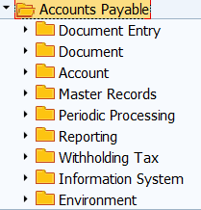
Accounts Payable
Transactions
AP
Tcode | Description | Type
XK01, FK01 | Vendor master record | Master data
FB60 | Enter Invoice | Transactional
FB03 | Display document | Transactional
F-53 | Outgoing payments | Transactional
F110 | Mass payments | Transactional
FB08, FB80 | Reverse document | Transactional
FKL5N | Account line items | Transactional
FK10N | Display balances | Transactional

Slide 71
Accounts Payable
Master Data: Vendor Master
AP
Vendor Master Account is data needed to conduct business with vendors and execute transactions related with the purchasing process
General (Client)
Accounting (Company code)
Account
Name
Address
Payment terms
Payment method
Reconciliation account
Bank information

Slide 72
Accounts Payable
Sub-ledger and Open Item Management
AP
GL Account (reconciliation)
  For each sub ledger account you must keep at least one reconciliation account in the general ledger.
Subledgers (vendors)
  Sub ledger postings automatically posts to the corresponding reconciliation account in the general ledger.
Open item management
  Allows you to control if an AR document is paid (cleared) or not.

Slide 73
Accounts Payable
Invoice entry: Financial impact
AP
Company code
Posting & Document date
Transaction date
Document number
Currency
Line items
  Vendor (credit)
  GL accounts (debit)
  Amounts
Document date:
09/16/2018
Company code:
US00
Posting date:
09/16/2018
Currency:
USD
Document Number
1XXXXXXX
Transaction date:
09/16/2018
Item in document currency
Line
PK
Account
Cost center
Amount
001
40
75XXXX Rent
DEF Quality
$2,500.00
002
31
123 Vendor X
$2,500.00-

Slide 74
Accounts Payable
Outgoing payments: Financial impact
AP
Company code
Posting & Document date
Transaction date
Document number
Currency
Line items
  Vendor (debit)
  Bank (credit)
  Amounts
Document date:
09/01/2018
Company code:
US00
Posting date:
09/01/2018
Currency:
USD
Document Number
1XXXXXXX
Transaction date:
09/15/2018
Item in document currency
Line
PK
Account
Amount
001
25
123 Vendor X
$2,500.00
002
50
10XXXX Bank
$2,500.00-

Slide 75
Account Payable and Receivable
Reflection
What recommendations would you give to a new SAP implementation in regards the settings for vendor and customer master records?
What are the benefits of AP and AR subledger?
How do you link the AP and AR sub-ledger and the postings to FI?
What are the benefits of the open item management functionality in accounts payable and accounts receivable?
Why the multi-currency functionality of SAP is one of its greatest benefits?

Slide 76
SAP Finance (FI)
Reflection
It is month end at GBI and the accounting group is working on its month end close, what activities would you need to review in each of the areas below
  Accounts Receivable
  Accounts Payable
  Asset Management
  General Ledger

Slide 77
Summary of Lecture
Finance management topics
  Financial Statements
Introduction to SAP Finance
  Goal of SAP Finance
  SAP FI Org structure
  New General Ledger
  Accounts Receivable
  Accounts Payable
  Asset Management

Slide 78
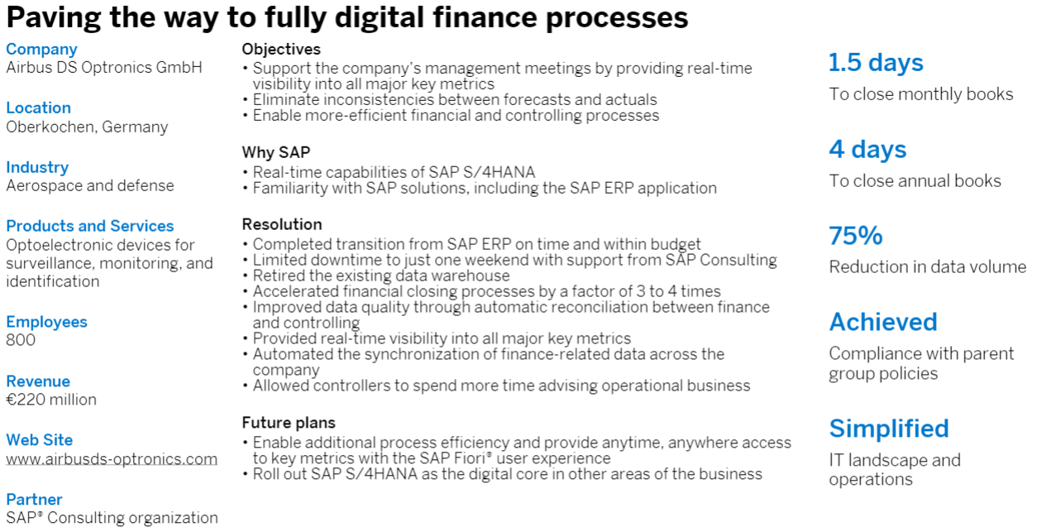
SAP Finance (FI)
The case of Airbus
A manufacturing company in a very competitive industry needs real-time visibility. How to improve the ecosystem and improve financial close cycle by 50%?
https://www.sap.com/products/financial-management.html#pdf-asset=4c7f01be-7a7c-0010-82c7-eda71af511fa&page=1

Slide 79
SAP Finance
Practice
Create account in CoA
Create cost element
Expense account
Create AR invoice
Run financial statements
Post payment
Post cash collection
Display balances
Display line items
Create vendor
Create AP invoice
Create customer
Create asset master
Post asset acquisition
Master data
Transactional data
Display

Slide 80
SAP Finance
Practice: Data relationship
GL master
Vendor
Cost element
Asset
Acquisition with vendor
Post AP invoice
Make a payment
Customer
Post AR invoice
Collect cash
Display balances & line items
Display balances and line items
Master data
Transactional data
Display

Slide 81
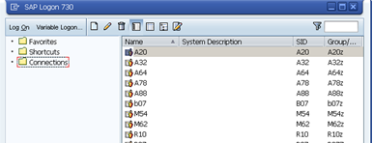

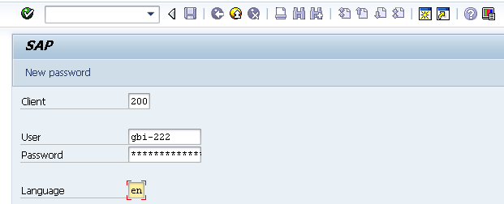
SAP Finance
User Logon Screen
Click on the icon in your desktop.
Enter the following information:
System ID: Eagle
Client: 118
User ID: LEARN-XXX
Enter your password
Notes:
Enter Client, Server and Password
Client is a numeric field and this number represents a whole business entity.
Users are client specific which means that having a user identification in one client will only allow access to that particular client.
The system settings are stored in a file on your machine called the saplogin.ini file. This file is normally preconfigured centrally and then made available to all the users. Once you have been provided with the SAP Logon, you need a username and password to logon to the SAP system. The username and password is unique for each user and you do have the option to change your password using the New password button available on the screen.

